Slide 1
Parallel Search Algorithm
By: Mehdi Amini
Spring 2012
Isfahan University Of Technology

Slide 2
OutLine:
Type Of Search Algorithms
Searching in Artificial Intelligence
Sequential Depth First Search
Sequential Best First Search
Parallel Depth First Search
Parallel Best First Search
Another Parallel Searches
Conclusion

Slide 3
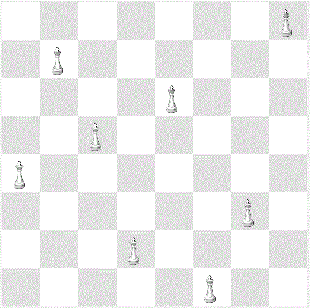
Type Of Search Algorithm:
We want to Find element

Slide 4
Type Of Search Algorithm:
Initial state
Goal state
8 | 1 | 7
6 | 5 | 3
2 | 4
1 | 2 | 3
4 | 5 | 6
7 | 8

Slide 5
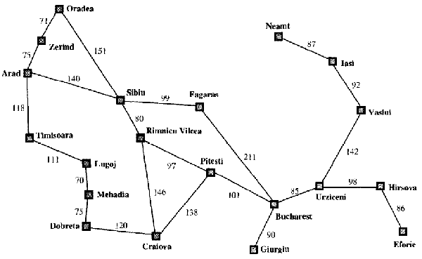
Type Of Search Algorithm:

Slide 6
Type Of Search Algorithm:
Find the Largest key Or Smallest key in the array
20 | 2 | 13 | 12 | 10 | 9 | 8 | 7 | 3 | 4
Find the Special key in an Ordered Array or Binary Search
1 | 2 | 8 | 10 | 12 | 13 | 18 | 27 | 30 | 40

Slide 7
Searching in Artificial Intelligence:
There are Some Agents in AI for solving problems
We don’t have any knowledge about problem so we called this un-informed approach
We have some knowledge about problem so we called this
Informed approach

Slide 8
Un-Informed Approach:
Depth First Search
Bread First Search
What is Depth First Search?

Slide 9
Sequential Depth first Search:
Check each node ,Is it a goal node? if not expand it

Slide 10
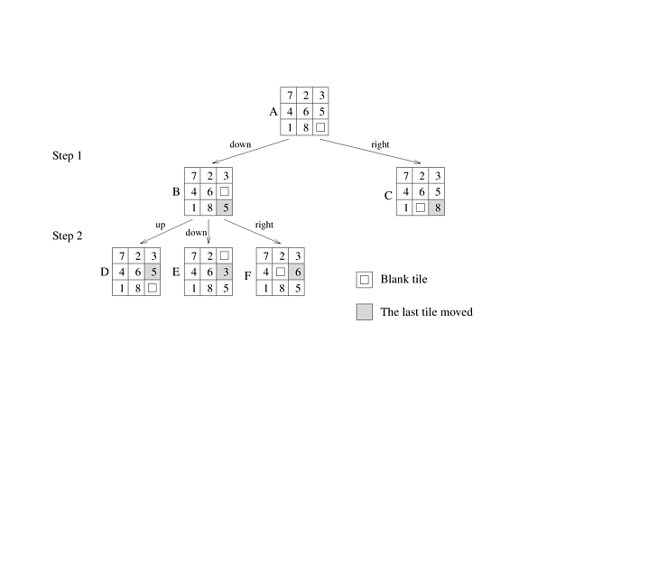
Sequential Depth first Search:

Slide 11
Sequential Best First Search:
In This approach Of search we have some knowledge about problem
In this Approach we want to find optimum Solution
What does knowledge mean?

Slide 12
Sequential Best First Search:
Check each node ,Is it a goal node? if not expand it
In this approach which node should be expanded?
80
90
100

Slide 13
Sequential Best First Search:
Our algorithm to solve the problem optimally is A*
In problem that we want to find a path between two point the knowledge is :f(n)=g(n)+h(n)
g(n):real cost of path between initial node to n
h(n):estimation of smallest path between n and goal node

Slide 14
Sequential Best First Search:
Arad
366=0+366
Timisoara
sibiu
Zerind
449=75+374
447=118+329
393=140+253
Arad
Riminicun
Fagaras
Oradea
646=280+366
415=239+176
671=291+380
413=220+193

Slide 15
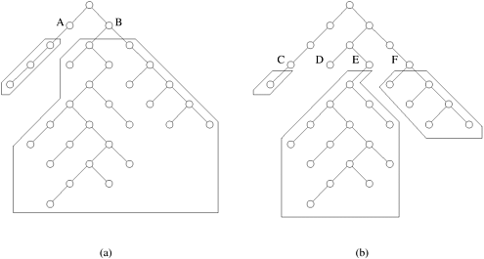
Parallel Depth First Search:
The critical issue in parallel depth-first search algorithms is the distribution of the search space among the processors

Slide 16
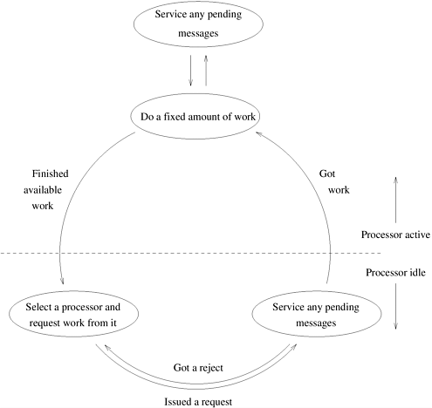
A generic scheme for dynamic load balancing

Slide 17
Parallel Depth First Search::
Important Parameters of Parallel DFS
Load -Balancing Schemas:
Asynchronous Round Robin
Global Round Robin
Random Polling

Slide 18
Parallel Best first Search:
This algorithm contains two main components:
Open list , Close list
In most parallel formulations of BFS, different processors concurrently expand different nodes from the open list

Slide 19
Parallel Best first Search:
There are two problems with this approach
The termination criterion of sequential BFS fails for parallel BFS
Since the open list is accessed for each node expansion, it must be easily accessible to all processors, which can severely limit performance

Slide 20
Parallel Best first Search:
A general schematic for parallel best-first search using a centralized strategy
Lock the list
p3
Lock the list
Lock the list
Unlock the list
p1
p2
Unlock the list
Unlock the list

Slide 21
Parallel Best first Search:
One way to avoid the contention due to a centralized open list is to let each processor have a local open list.
The processors must communicate among themselves to minimize unnecessary search

Slide 22
Parallel Best first Search:
Communication Strategies for Parallel Best-First Tree Search
random communication strategy
ring communication strategy
blackboard communication strategy

Slide 23
Parallel Binary Search Algorithm:
We have an ordered array ,we have two processors
We part our array to P+1 parts , where p is number of processors
1 | 2 | 8 | 10 | 12 | 13 | 18 | 27 | 30
p1
p2

Slide 24
References:
Introduction to parallel computings,addison wesley,second edition
Akihiro kishimato; alex fukunaga; adi botea; “Sclable,parallel best first search for optimal sequential planning”
Artificial interlligence:A modern approach , Russell and Peter Norvig,third edition
An introduction to Parallel algorithm,Joseph jaja

